Slide 1
SIX Slides@edX
Dr. Charles R. Severance
University of Michigan School of Information
www.dr-chuck.com

Slide 2
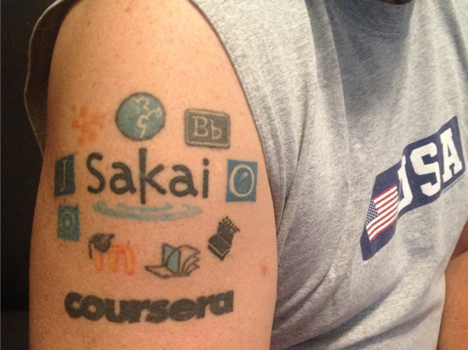
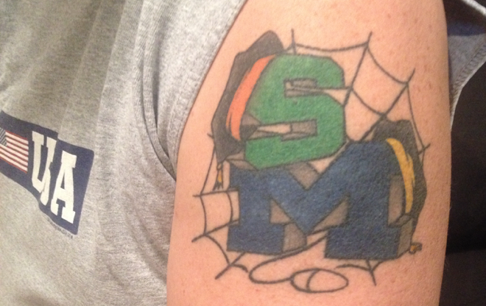
http://online.dr-chuck.com/
Twitter: @drchuck

Slide 3
Process: To Build a MOOC
Teaching PHP
Videos +
Auto-graders
-> Python
2017 Fall
2018 Winter
2018 Fall
2019 Winter
2019 Fall
2020 Winter
2020 Fall
Sabbatical
Grad Django(*)
UG Flask(*)
Django
MDN Tutorial
Videos
Django
Roll out DJ4E MOOCs
Record PG4E
Django
Django Tutorial
Demos
Record DJ4E
Grad PHP
Record WA4E
UG Flask(*)
Django
MDN Tutorial
Auto-graders
(*) taught by others

Slide 4
LTI Advantage®
CC®
LMS
FOR THE FIRST TIME IN THE HISTORY OF EDUCATIONAL TECHNOLOGY, YOU CAN MAKE AN APP STORE AND LEARNING OBJECT REPOSITORY WITHOUT PROPRIETATY EXTENSIONS.
CC®, and LTI Advantage® are trademarks of IMS Global Learning Consortium, Inc. (www.imsglobal.org)

Slide 5
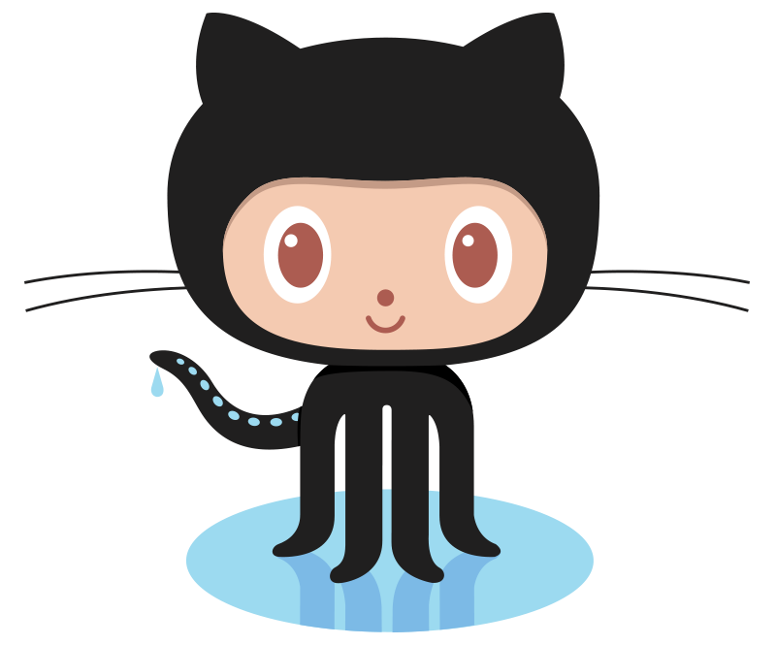
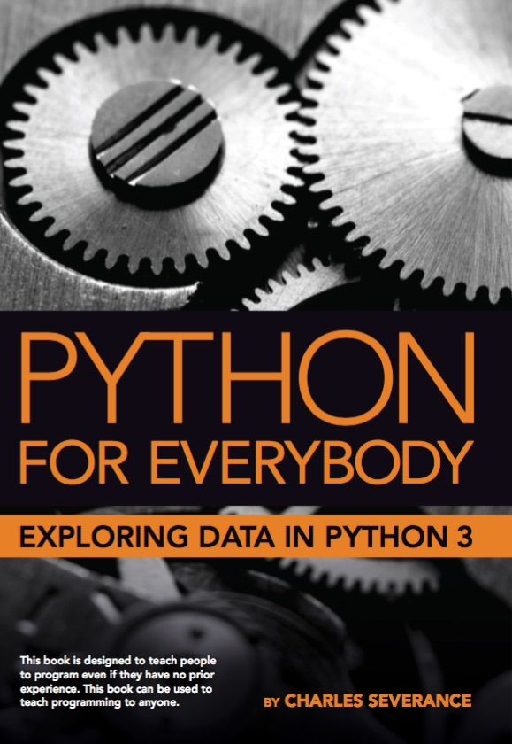
120
LTI Apps
Pages
Files
Graders
Book
57K
LOR/MOOC py4e.com
Autograders (次)
Modules
OER Content (코스)
IMS
Canvas
edX
Pandoc
Coursera
KDP
Media
FutureLearn
archive.org
YouTube
Amazon
ITunes
Google Play

Slide 6
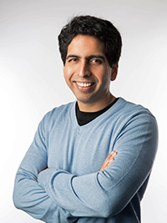
What Sal Khan Did Wrong
Accepted the existing K12 curriculum
Ignored standards, interoperability, and reuse
Did not build Open Educational Resources
All about driving teachers and students to his brand
Single instance software – not open source
Silicon valley / entrepreneur mindset – growth / brand

Slide 7

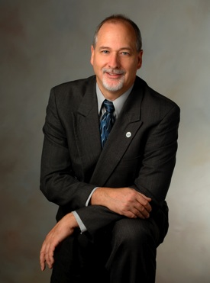
Education for Everybody
Open source software
Open standards / interoperability
Open educational App Store
Open book / materials (MyMathLab)
Teach skills not curriculum – K12 / dummies / CS
If we only have the attention of the student for four weeks, what subset of a topic would we teach?
https://www.online.dr-chuck.com/

